Slide 1
The self after trauma: a practical look at the clinical applications of ACT
Ashley Greenwell, PhD
Trauma Psychologist
Self-portraits: Kahlo, Van Gogh, Warhol, Courbet

Slide 2
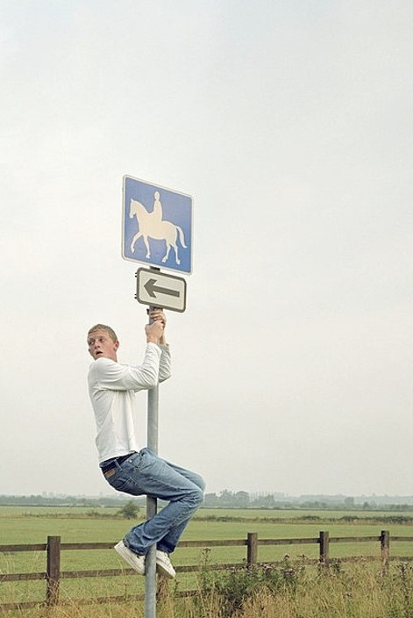
We are forced to speak of “I” through myth-that is through special metaphors, analogies, and images which say what it’s like, distinct from what it is. This can be falsehood at the extreme, and it can also be a useful and fruitful way we make sense of life. But this myth is not to be taken literally. One must take care not to confuse an image with precise fact (which would be like climbing up the signpost instead of following the road).
-Alan Watts, 1966

Slide 3
Healthy selfing in us & our clients McHugh, Stewart, & Almada, 2019
A flexible self is not confined by following rigid social and internal norms, nor by having to act in direct opposition to them.
After trauma, holding our identities tightly can bring a sense of security and familiarity, but also trap us.
In what ways does our sense of self enhance or restrict psychological flexibility and thereby influence the ability to adapt after trauma?

Slide 4
As we go, I invite you to experience this content as a choose your own adventure…

Slide 5
Case Examples(*identifying information has been changed)
“Sam”
Distraught police officer whose daughter recently died by suicide.
“Anna”
Highly accomplished and exhausted. Life feels empty near her retirement. Extensive war trauma before resettling in the US. Decades ago, shortly after arriving, experienced the accidental death of her husband.
*How are they behaving verbally with regard to their behavior?
-Hayes, Barnes-Holmes, & Roche, 2001

Slide 6
Initial Assessment Measures
Daily Valued Action Questionnaire (DVAQ)
Berghoff et al., 2018
Posttraumatic Stress Disorder Checklist (PCL)
Blevins et al., 2015
Self as Context Scale (SACS)
Centering: reacting calmly to unwanted psychological experiences
Transcending: the observing self
Zettle et al., 2018
Sheehan Disability Scale (SDS)
Work/Student, Social, Family/Home
Sheehan et al., 1996

Slide 7
Intake Measure Results
 | PCL | SACS | Sheehan | DVAC
Sam | 52 | T=21 C=8 | 11 | 3.4
Anna | 23 | T=29, C=16 | 1 | 5.2
= score inconsistent with clinical interview responses

Slide 8
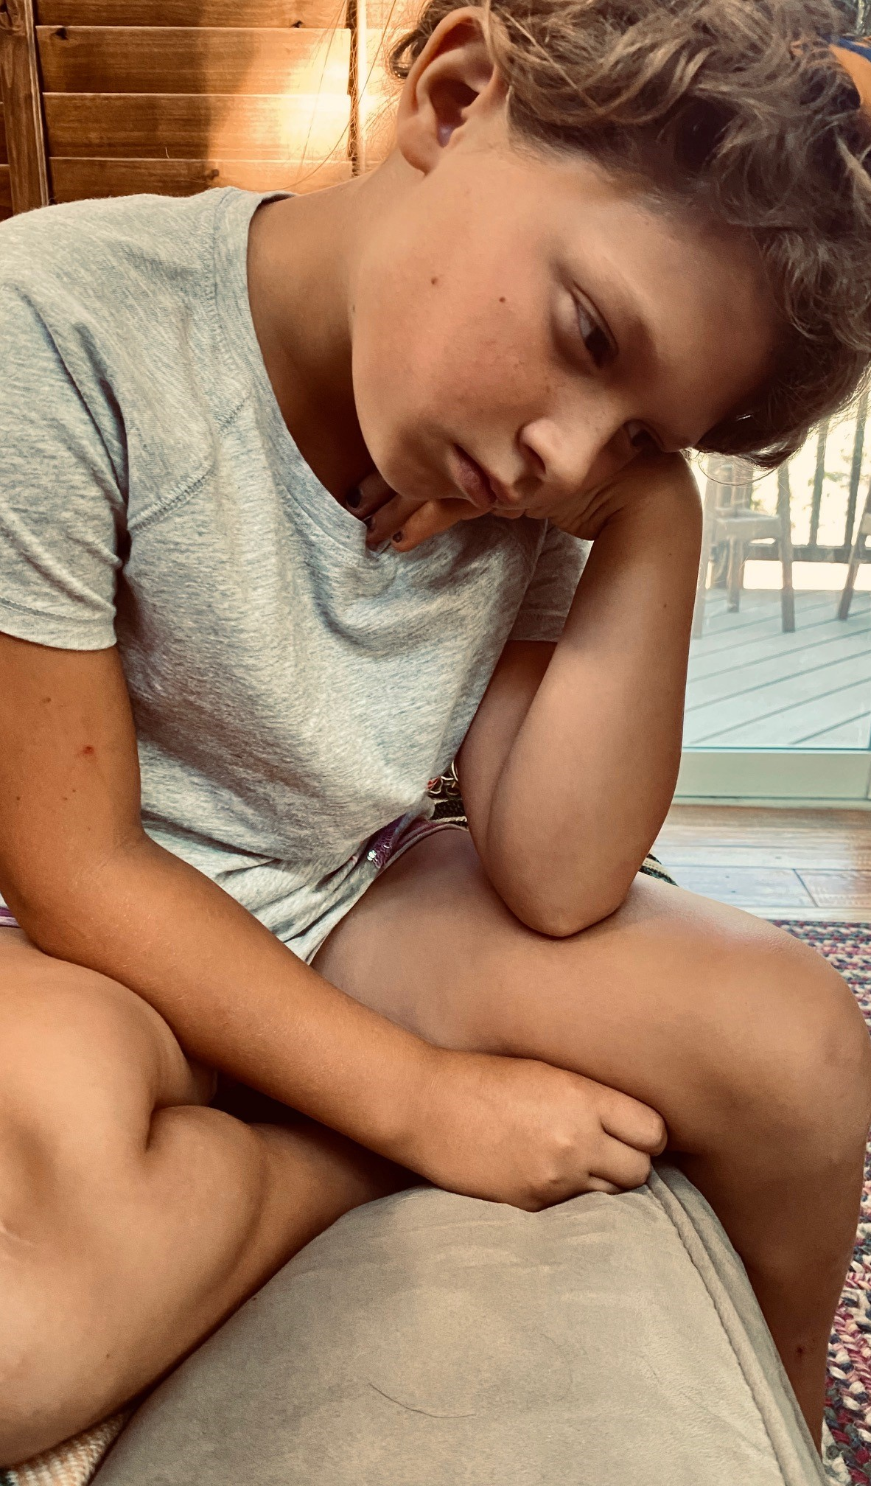
Process approach to standardized assessment
Sam: Yep, I’m a mess.
Anna: Yes, I can do these things (i.e. skills). It’s not a problem. Please also send me the journal articles for these measures so I understand them well.

Slide 9
Self-content issues
 | Selfing | Rule | Function/Workability
Sam | My life is a succession of huge failures. | I have to take responsibility and accept my punishment. | + Stabilizing, S/I - Values inconsistent
Anna | I bring order to chaos for others. | I must help everyone else, and my therapist needs to stop the chaos for me. | + Somewhat values consistent - No longer workable
Psychologist (me) | I alleviate others’ suffering. | I have to find a way to stop their pain and fix this. | + Engagement, motivation - Overly responsible for

Slide 10
Interventions for Selfing Processes
Perspective taking Exercises
I / You
McHugh, Stewart, & Almada, 2019

Slide 11
Interventions
I as perspective
Notice who is noticing
McHugh, Stewart, & Almada, 2019

Slide 12
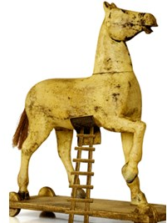
Interventions
I as Various
Father to an infant, toddler, middle schooler, high schooler
Adapted from Hayes, 2019
Trap of subtly meeting client’s fixed beliefs with my own

Slide 13
Interventions
I as Flexible
McHugh, Stewart, & Almada, 2019

Slide 14
Follow up assessment results at 3 months
 | PCL | SACS | Sheehan | DVAC
Sam | 51 (∆ -1) | T=21 (=) C=9 (∆ +1) | 5 (∆ -6) | 3.5 (∆ +.1)
Anna | 37 (∆ +14) | T=27 (∆ +2) C=17 (∆ +1) | 3 (∆ +2) | 5.2 (∆+.7)

Slide 15
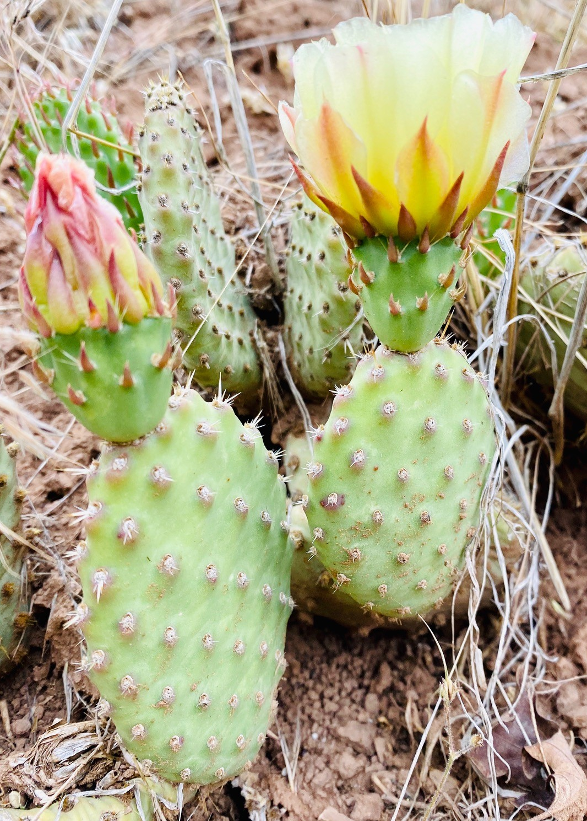
Epilogue
Sam
When shit hits the fan, you fall to your lowest level of training. After her death, I leaned on my old way of seeing myself and the world. I know the system I’ve been following assigns me all the responsibility for her suicide and nothing else I did as a father, but it just feels “right.” It’s creating problems to keep seeing it this way. Someday, I’d like to act from the belief that I made the best decisions I could along the way as her dad. Right now, helping others is the only thing that brings meaning.
Anna
Chaos is always around, but I can revisit it now, and it feels different. If I can notice the chaos as my tight chest, I know I am more than that. I’m not the person that has to control it.
Major life changes in service of her values AND anger and grief at life being much more painful than she ever would have hoped it would be and at my lack of a remedy.

Slide 16
Practical Considerations
“Functional assessment of selfing is not easy,” but worth the time
Processed based assessment for individuals (add here)
McHugh, Stewart, Almada, 2019
Tension between fidelity and in the moment clinical utility
Psychotherapy often expects a prerequisite set of interpersonal behaviors that can be difficult for trauma survivors
e.g. consenting, tacting, dissenting
Need for orientation to slowed pacing and consideration of client’s dysregulation
Degree of presence required to be effective & prevalence of burnout.
Additional research and application of trauma & selfing principles

Slide 17
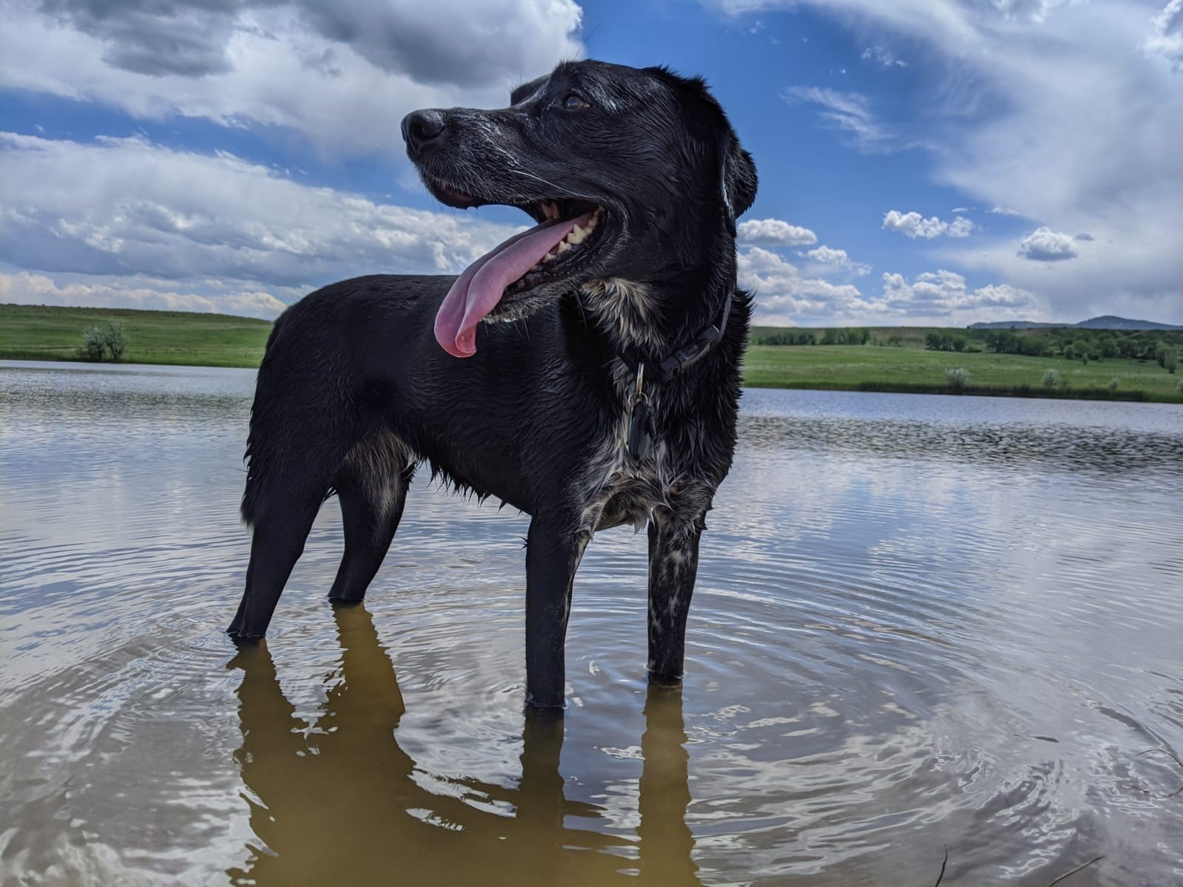
Ashley.Greenwell@ucebt.com
Contact info:
Thank you to: My clients - S. batten, C. & M. Levin, M. Twohig, K. Morrison
Notes:
. If this can help any one then…..People whose patient dialogues and teaching has shaped my understanding of ACT

Slide 18
References
Berghoff, C. R., Forsyth, J. P., Ritzert, T. R., Eifert, G. H., & Anderson, D. A. (2018). Evaluation of the contribution of values clarification to a brief mindfulness meditation intervention for anxiety. Journal of Clinical Psychology, 74(9), 1387-1402.
Blevins, C. A., Weathers, F. W., Davis, M. T., Witte, T. K., & Domino, J. L. (2015). The posttraumatic stress disorder checklist for DSM‐5 (PCL‐5): Development and initial psychometric evaluation. Journal of traumatic stress, 28(6), 489-498.
Hayes, S. C. (2019). A liberated mind: How to pivot toward what matters. Penguin.
Hayes, S., Barnes-Holmes, D., & Roche, D. Relational frame theory: A post-Skinnerian account of human language and cognition. Springer Science & Business Media, 2001.
McHugh, L., Stewart, I., & Almada, P. (2019). A contextual behavioral guide to the self: Theory and practice. New Harbinger Publications.
Milo, D. S. (2019). Good enough: the tolerance for mediocrity in nature and society. Harvard University Press.
Sheehan, D. V., Harnett-Sheehan, K., & Raj, B. A. (1996). The measurement of disability. International clinical psychopharmacology.
Watts, A. (1966). The book: On the taboo against knowing who you are.
Zettle, R. D., Gird, S. R., Webster, B. K., Carrasquillo-Richardson, N., Swails, J. A., & Burdsal, C. A. (2018). The self-as-context scale: Development and preliminary psychometric properties. Journal of Contextual Behavioral Science, 10, 64–74. https://doi.org/10.1016/j.jcbs.2018.08.010

Slide 19
Could I be a stem cell right now, pure potential? Capable of anything? From this place of undiluted possibility, can we follow any direction at any time, unencumbered by the accrued self?
--Daniel Milo (from Good Enough: The tolerance for mediocrity in nature)

